Slide 1
OBSTACLE AVOIDANCE CAR USING ULTRASONIC SENSOR & SERVO MOTOR
Presented By
Abhishek Kumar

Slide 2
Abstract
The main scope of project is to automatically changing the direction of robotic vehicle as required whenever any obstacle comes on its way.
Here an ultrasonic sensor is used which detects the presence of any obstacle and sends the signal to Arduino which changes the direction of the car.
This car will keep on moving in straight line until something comes in its path that’s when it decides to turns into some other direction so it successfully avoids the obstacle.

Slide 3
Components Required
Arduino UNO
H-Bridge motor drivers L293D
Ultrasonic sensor
Motor chassis
Male/Female jumper wire
Breadboard
DC motors
12V Battery

Slide 4
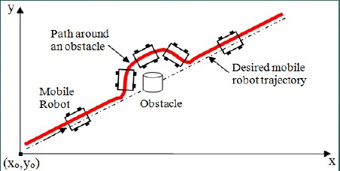
What is a obstacle avoidance robot?
Obstacle avoidance is a means of a car being able to move around in an unknown environment without colliding with surrounding objects

Slide 5
What is a sensor?
A sensor is a device that detects and responds to some type of input from the physical environment.
The specific input could be light, heat, motion, moisture, pressure.
The output is generally a signal that is converted to human-readable form.

Slide 6
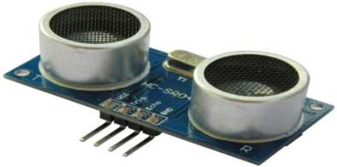
Introduction to Ultrasonic Sensor
What is a ultrasonic?
ULTRA – BEYOND
SONIC – SOUND
The sound beyond human hearing range ( 20,000 Hz ) is known as ultrasonic.
Ultrasonic sensor?
Ultrasonic sensors are sensors that convert ultrasound waves to electrical signals or vice versa.

Slide 7
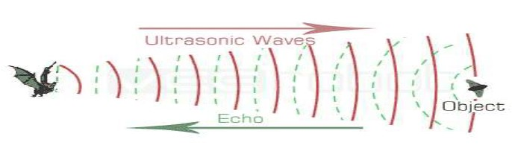
How does an ultrasonic sensor works?
How does a bat sense distance
Bats sense distance using sound.
They emit sound waves and receive back reflected waves.
The time it takes to receive the waves back provides them with a very good estimate of the distance.
This is exactly how ultrasonic sensors estimate distance.

Slide 8
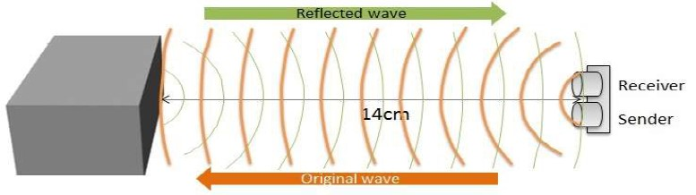
An ultrasonic sensor has two parts:
A transmitter that sends out a signal that humans cannot hear.
A receiver that receives the signal after it has bounced off nearby objects.
The sensor sends out its signal and determines how long the signal takes to come back.

Slide 9
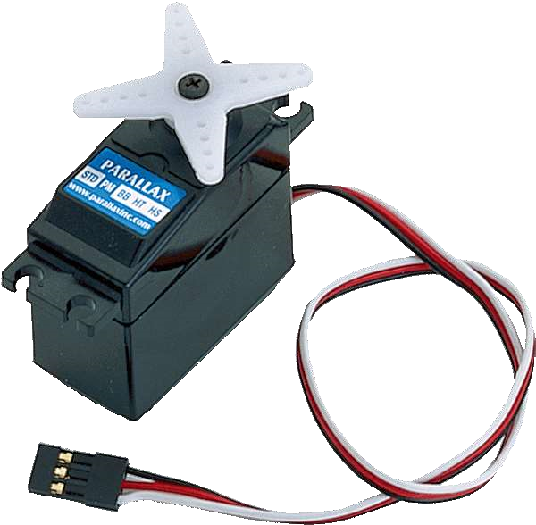
SERVO MOTOR
What is a servo motor?
A servomotor is a rotary actuator or linear actuator that allows for precise control of angular or linear position, velocity and acceleration.
It consists of a suitable motor coupled to a sensor for position feedback.

Slide 10
H-Bridge motor drivers L293D
L293D is a dual H-bridge motor driver integrated circuit (IC).
Motor drivers act as current amplifiers since they take a low current control signal and provide a higher-current signal.
L293D contains two inbuilt H-bridge driver circuits. In its common mode of operation, two DC motors can be driven simultaneously, both in forward and reverse direction.

Slide 11
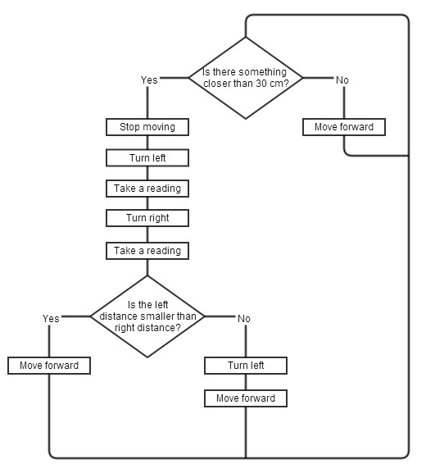
Algorithm for obstacle avoidance robot

Slide 12
WORKING
The obstacle avoidance robotic car uses ultrasonic sensors for its movements. Arduino is used to achieve the desired operation.
The ultrasonic sensor is attached in front of the robot.
Whenever the car is going on the desired path the ultrasonic sensor transmits the ultrasonic waves continuously from its sensor head.
Whenever an obstacle comes ahead of it the ultrasonic waves are reflected back from an object and that information is passed to the Arduino Uno.

Slide 13
The Arduino controls the motors left, right, back, front, based on ultrasonic signals.
When ultrasonic sensor detect the object which is kept inside the path it will send the signal toward the Arduino Uno and according to that it will rotate the motor.
The vehicle moves forward in that direction where it gets the maximum distance.
Similarly in every time when ever an obstacle in found to be in path of car it will detect it and rotate the car in particular direction to avoid the obstacle.

Slide 14
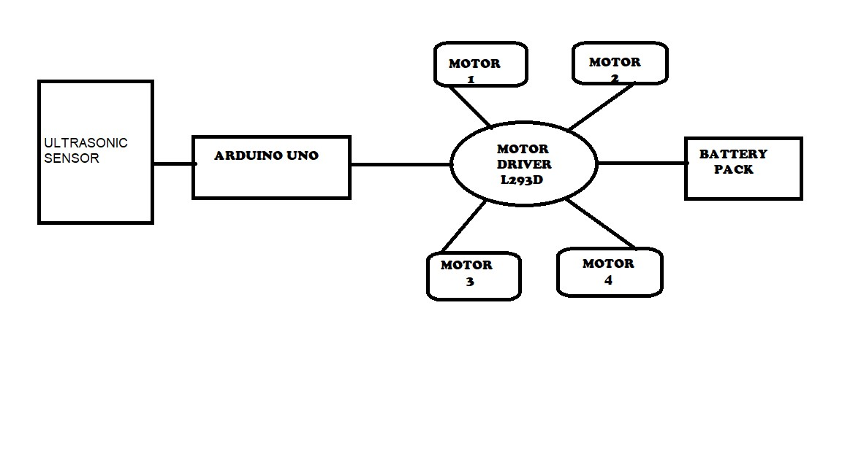
BLOCK DIAGRAM

Slide 15
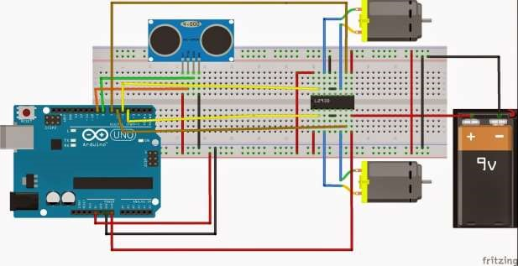
Connections

Slide 16
ADVANTAGES
It can be used as a movable Surveillance System.
It can be controlled remotely.
It does not require Man Power.
It can be used for critical application like flood, bomb disposal, Fire, Terrorist attack, Earth quake, Spying.

Slide 17
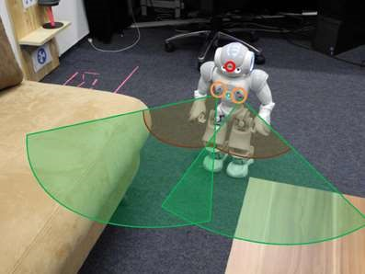
Applications
Automated lawn mover
Obstacle avoiding robots can be used in almost all mobile robot navigation systems.
Unmanned vehicle driving
Mining Vehicle that uses Obstacle Detection
It can be used for army applications
Obstacle sensing robot can be applied at toys where small children will play

Slide 18
CONCLUSION
The goal of our project is to create a autonomous robot which intelligently detects the obstacle in his path and navigate according to the actions we set for it.

Slide 19
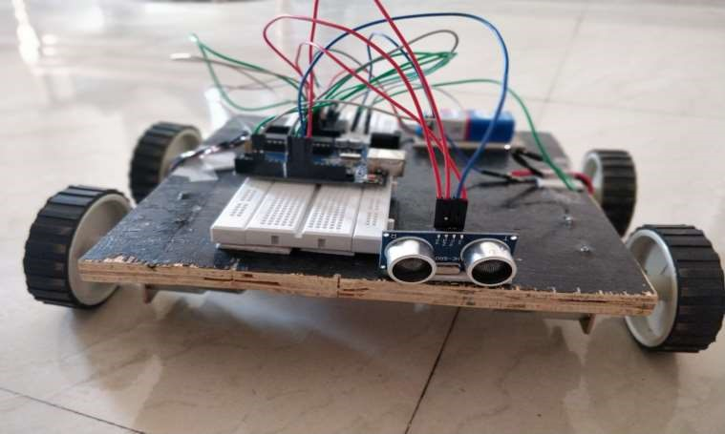
Obstacle avoidance robot

Slide 20
THANK YOU

